Slide 1


React + Redux
By Cheenee Colaste

Slide 2
Agenda
Basic ES6(ES2015)
Promise
React Components Life Cycle
Redux
Hands-on Example

Slide 3
ES6

Slide 4
What is ES6?
Highlights:
Better syntax, more verbose.
Better code structuring.
Lesser effort/number of lines than ES5.
The future Javascript.
Notes:
Why Should We Bother use it?

Slide 5
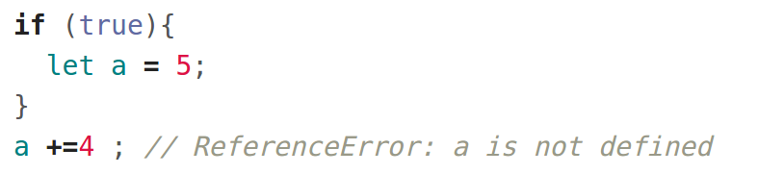

ES6 - let/cont
Notes:
Let:
Block scoping
Const:
Value will never change
It will prevent you to accidentally change the value
Other developer will automatically notice that this variable is constant

Slide 6
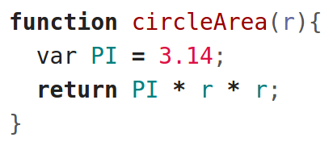
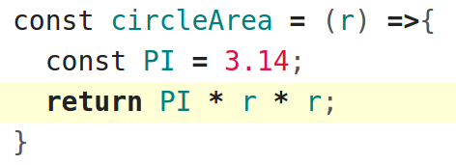
ES6 - Arrow Functions
ES5:
ES6:
Shorthand
Notes:
So next time you will see this syntax you will know that this is the new ES6 arrow function

Slide 7
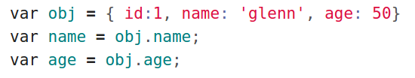

ES6 - Destructuring
ES5:
ES6:

Slide 8

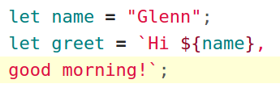

ES6 - Template Literals
ES5:
Output
ES6:
Output
Notes:
Use backtick
If you enter it will automatically trigger a new line

Slide 9
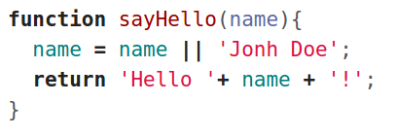
ES6 - Default Parameters
ES5:
ES6:

Slide 10

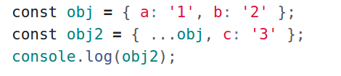
ES6 - Object Spread
ES5:
ES6:

Slide 11
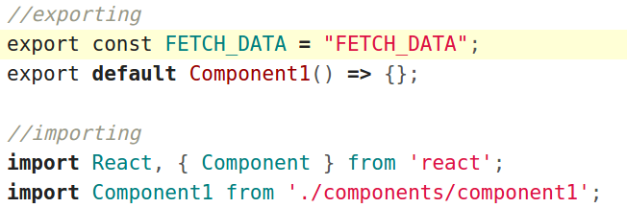
ES6 - Modules
Notes:
Tips : one of the common errors in React is forgetting to export the components to make it accessible to other components

Slide 12
Promise

Slide 13
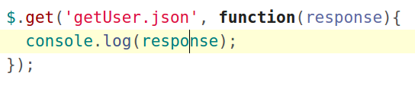
What is callback function?
A callback function is executed after current effect is finished.
example:
Callback function
Notes:
Callback is a way of telling your code that when this thing is done execute this piece of code

Slide 14
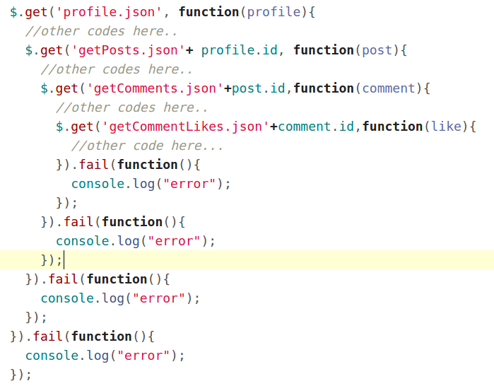
What is a callback hell?

Slide 15
What is a promise?
Promises are an alternative way of manage asynchronous code in javascript
It is way better than callbacks.
Lots of library are using promises like axios and also in the latest version of node js
var promise = new Promise(function(resolve, reject){
setTimeout(function() {
console.log('some asyn task just completed');
resolve({data: '123'});
}, 2000);
});
Notes:
A promise is basically an object with two functions on it, a function name then and a function named catch.
‘Then’ function is called anytime the promise is successful.
‘Catch’ function is called anytime something bad has happened.
Promises serves the same purpose as callbacks do but promises are a bit more powerful because they are composable unlike callbacks

Slide 16
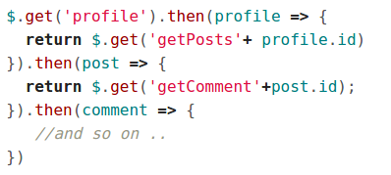
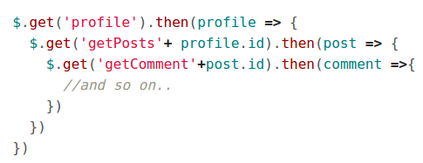
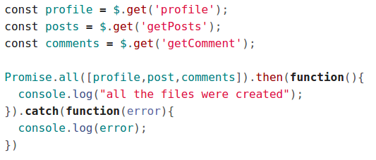
Different promise compositions
Promise chains
Promise all
Notes:
Note : show them how to make a promises here are the basic examples https://html5hive.org/how-to-chain-javascript-promises/

Slide 17
React
Notes:
I assume that you are already familiar in React

Slide 18
React Component Lifecycle Methods
componentWillMount - is executed before rendering, on both server and client side.
componentDidMount - is executed after first render only on the client side.
componentWillReceiveProps - is invoked as soon as the props are updated before another render is called.
componentWillUnmount - is called after the component is unmounted from the dom. We are unmounting our component in main.js.
Notes:
These are the most commonly used component lifecycle:
componentWillMount - example calling an action that will load all the initial data or lists
componentDidMount - is invoked only on the client. More on rendering views
componentWillReceiveProps - example you push an update in your API then you can use this to update your component view
componentWillUnmount - you can use this to unbind your event listeners like onClick, onChange and etc so that you can prevent dom memory leak (aggressive caching).
Reference in memory leak: https://softwareengineering.stackexchange.com/questions/173627/why-do-browsers-leak-memory

Slide 19
Redux
Notes:
Reference: https://github.com/learncodeacademy/react-js-tutorials/tree/master/4-redux/src

Slide 20
Redux Diagram
Notes:
Tips: if you are building a small component app you can just use react to keep all your data in a state on your maybe layout level component.
But if you’re going to be building more of an Application use flux, flux sets up very quickly and it’s really stable in a lot of ways
Note: Redux is a total separate project from react
Action + Store + Reducer = Redux
View = React
Store is immutable it doesn’t change state it just create new state
Previous state + action = new state

Slide 21
HANDS-ON
Redux Single & Multiple Reducer
Notes:
Note: never ever mutate a state
Code reference code acdemy

Slide 22
React + Redux
Action Creators
Middleware
A
A
Dispatcher
A
Store
Reducers
Store
R
R
R
Components
(Dumb Components)
Containers
(Smart Components)
Components
(Dumb Components)
Containers
(Smart Components)
Components
(Dumb Components)
Containers
(Smart Components)
State
Provider
Notes:
Note: Redux is a total separate project from react
Action + Store + Reducer + Provider + Container & Components = ReactRedux
Provider - Makes store available to all containers
What is middleware - para siyang validator, siya yung nag chcheck kung valid ba tong action or may mamanipulate muna niya yung action before nya ipasa kay store
Note: demo logger and thunk.

Slide 23
HANDS-ON
React + Redux
Notes:
Demo mini book list app + middleware

Slide 24
Dev Tools
Chrome extension React
https://chrome.google.com/webstore/detail/react-developer-tools/fmkadmapgofadopljbjfkapdkoienihi
Chrome extension Redux DevTools
https://chrome.google.com/webstore/detail/redux-devtools/lmhkpmbekcpmknklioeibfkpmmfibljd
Notes:
Note: To make the redux devtool work you need to add the dev tool middleware. Follow the instruction here: https://github.com/zalmoxisus/redux-devtools-extension#usage

Slide 25
END

